Slide 1
How to Spot the Right Development Site & Determine its Potential Yield
Marc Terry, Parker Scanlon Surveying & Town Planning

Slide 2
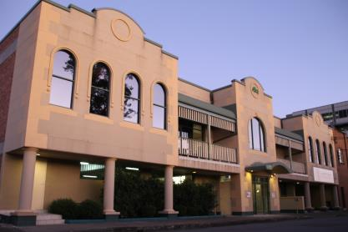
Parker Scanlon
Founded April 2007
Now employing over 20 staff members
Consultants in Surveying, Town Planning, Bushfire Assessment & Project Management
New Office – 17 William Street, Hamilton

Slide 3
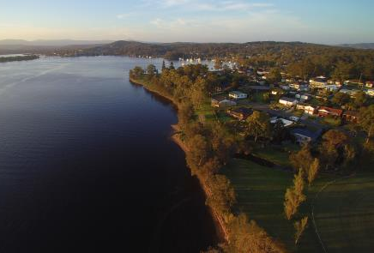
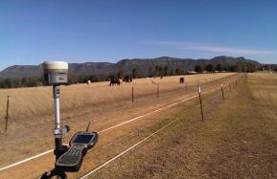
Parker Scanlon
Utilizing the latest technologies;
GPS
Robotic Theodolites
UAVs (Drones)
LIDAR

Slide 4
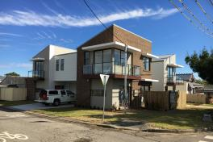
Parker Scanlon
Clients Include;
Project Home Builders
Residential & Commercial Developers
Local Councils
Conveyancers
Shopping Centre Management
“Mum and Dad” Developers

Slide 5
The Top Ten

Slide 6
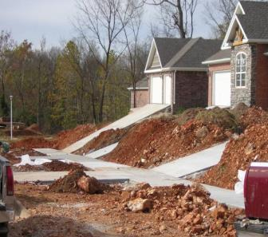
1. Site Access
Legally all properties must have a road frontage for access, waste collection and provision of services;
In some cases access from a laneway may be permissible but can present issues (is the lane Publicly or Privately owned?);
Enough land to accommodate a battle-axe handle?;

Slide 7
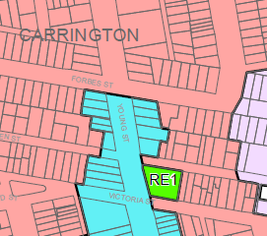
2. Zoning & Lot Size
Rules change between different Council areas, check the Local Environmental Plan (LEP);
Different rules for Torrens/Strata/Community Title Subdivision;
Enabling clauses in LEPs allow smaller lot sizes when subdivision is to occur in conjunction with new dwelling construction;
SEPP 1 Objections & Clause 4.6 Variations.

Slide 8
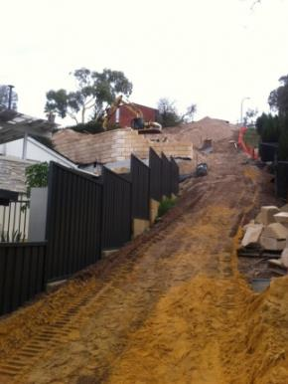
3. Site Slope
Driveway Access;
Maximum slope across building envelopes;
Retaining walls – expensive and setbacks required may reduce development yield;
Requirement for a Geotechnical Report.

Slide 9
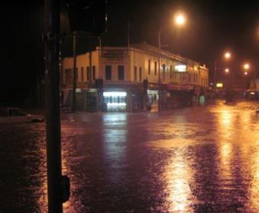
4. Flooding
Many parts of the Hunter Region flood effected, confirm if the land is effected with;
Section 149 Certificate (part of most sales contracts);
Flood Prone Land maps available on most Council websites;
Flooding Certificate (application can be made to Council and will nominate a minimum floor levels for new development);
In some cases a Flood Study by an independent consultant may be required (adding costs and delays).

Slide 10
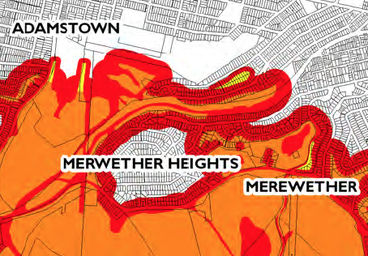
5. Bushfire Prone Land
Majority of Lake Macquarie Council is mapped as being bushfire prone land along with many outer suburbs of Newcastle City Council;
Rural Fire Service sets guidelines for minimum setback of houses from bushland and the use of different building materials to mitigate risks;
Cannot create a subdivision lot that is in a flame zone.

Slide 11
6. Drainage
How will stormwater leave the site?;
A lot that slopes to the road is preferable;
A lot that slopes to the rear may require an easement/easements through neighbouring land to access Council’s trunk drainage network or a natural watercourse;
Negotiations with neighbours can add time and cost to the planning process;
Easements imposed by Court order (Section 88K).

Slide 12
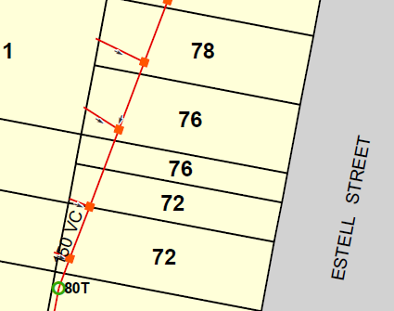
7. Services
Dial Before You Dig (DBYD) searches are free and provide an indication of the approximate location of all known underground services;
Location of sewer most important to consider, only service that requires gravity to work;
Sewer is the service most likely to run through a lot rather than in the road reserve.

Slide 13
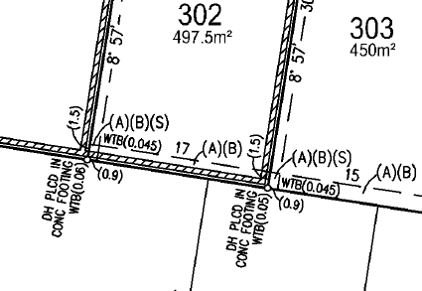
8. Easements
A site with existing Easements, Restrictions or Covenants typically have a lower yield than an unencumbered site;
Restrictions on the Use of Land may even attempt to prevent subdivision or development;
Certificate of Title lists all encumbrances but a thorough inspection of the terms of each by a suitably experienced professional may be required.

Slide 14
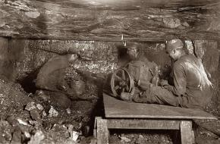
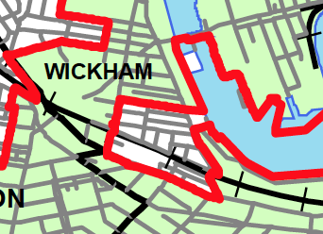
9. Mine Subsidence
Old underground mine workings under much of the land in Newcastle and surrounding Councils and are the hidden killer of many developments;
All new buildings and subdivisions within nominated Mine Subsidence Districts must be approved by the Board;
The Board provides maps of approximate district boundaries on their website and can provide some initial feedback during due diligence stage through a quick phone call.

Slide 15
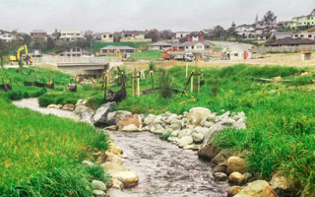
10. Riparian Boundaries
Riparian – “related to or situated on the banks of a river”;
May assist with stormwater disposal and may improve the visual amenity of the site;
Beware, in some areas a buffer of up to 40m on either side of the watercourse may be imposed for any building work;
If a Topographic map shows a “blue line” through or adjacent to your property further investigation is required.

Slide 16
Useful Links
SIX Maps (https://maps.six.nsw.gov.au)
Planning Portal (www.planningportal.nsw.gov.au)
Dial Before You Dig (http://www.1100.com.au)
Mine Subsidence Board (www.minesub.nsw.gov.au)

Slide 17
Parker Scanlon – Here to Help
Mark Scanlon – Managing Director & Surveyor
Ed Munday – Surveyor & Planner
John Sorby – Surveyor
Brad Draper – Planner & Bushfire Consultant
Madeline Thomas – Planner
Marc Terry – Surveyor
www.parkerscanlon.com.au
surveys@parkerscanlon.com.au

